Slide 1
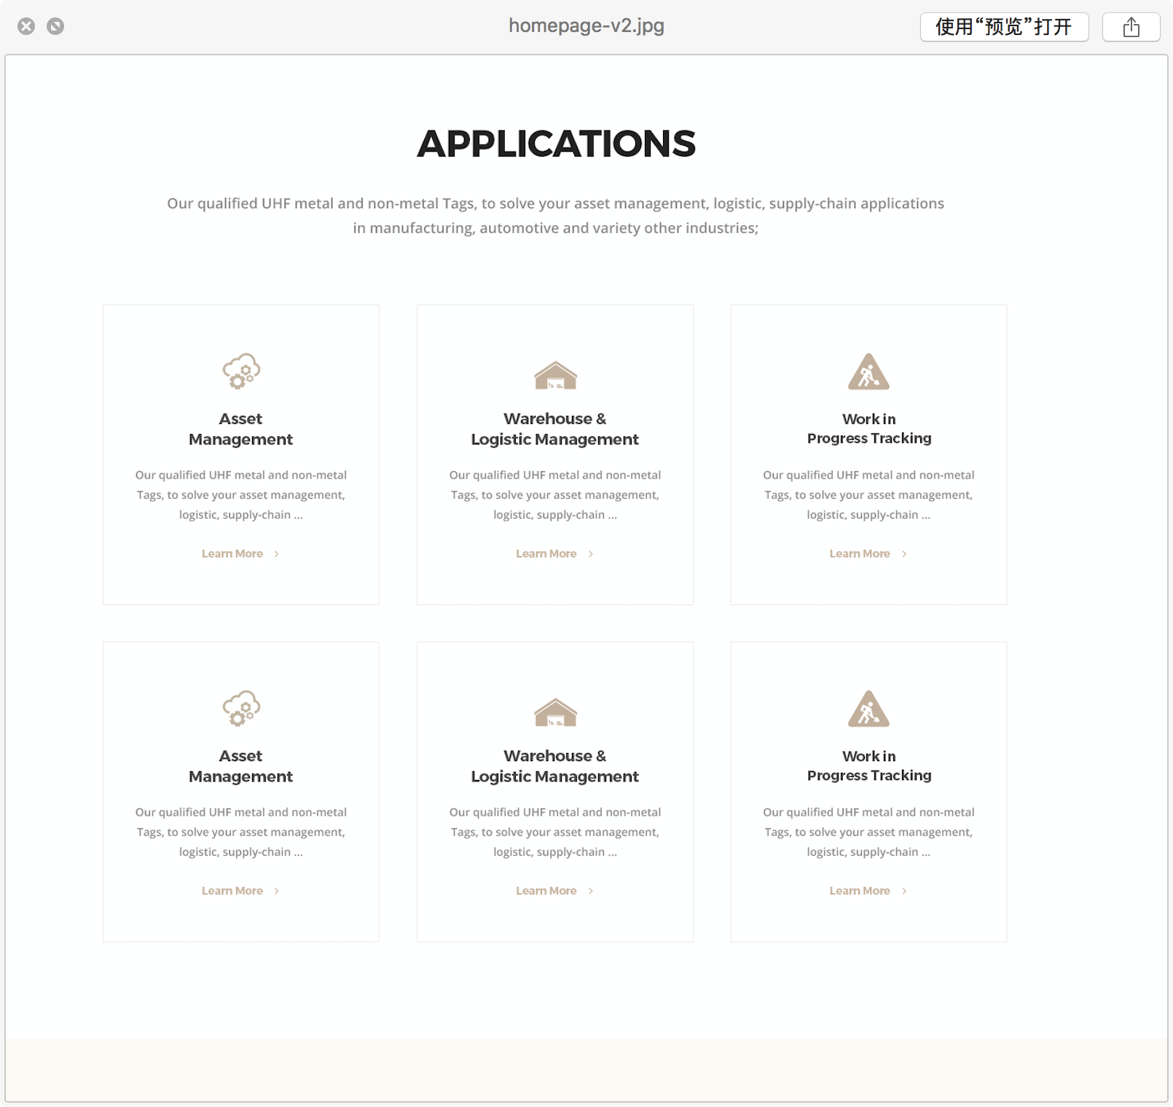
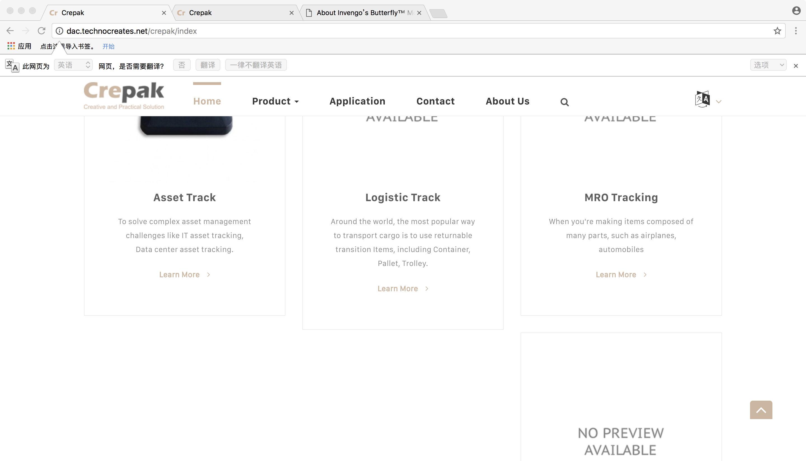
Comments：
for the consistence of the application boxes the content has to be added very carefully, the tile of the application must not be more than 2 line, the short description must not be more than 3 line as it is now in that section
Up one is application layout in mock up, the icon looks good, and the structure is also consistence, same height, same width, same space it takes;
Only need to be modified is the frame line of each application part, it is better to be removed
Down pic is current design, I don’t need a pic as icon to describe the application content, please keep using icon, and please provide the icon category for me to choose for each application
All the six applications look not consistent, please make it the same as mock up which is professional;

Slide 2
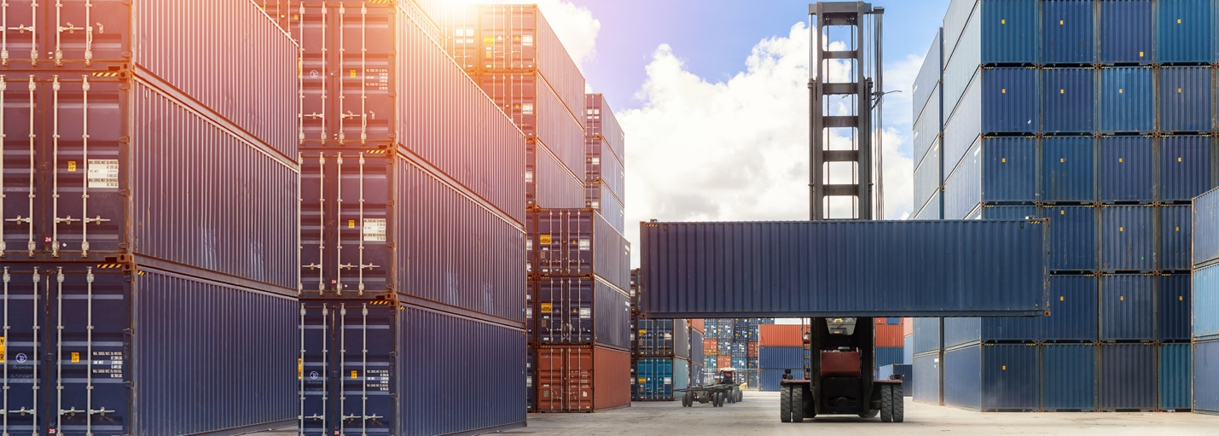
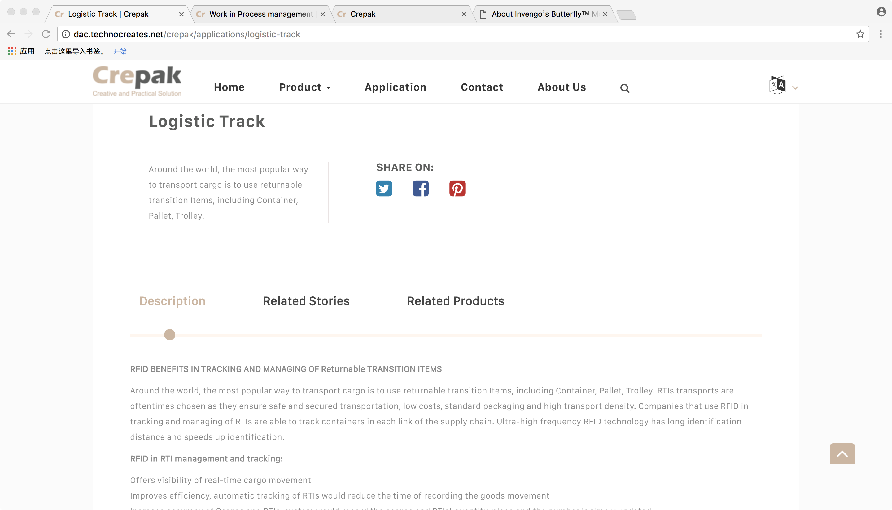
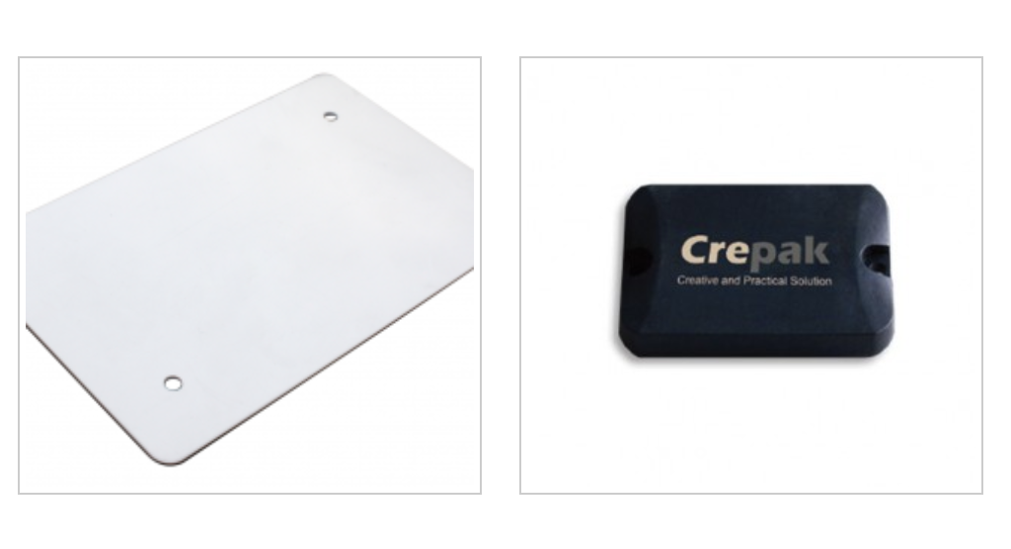


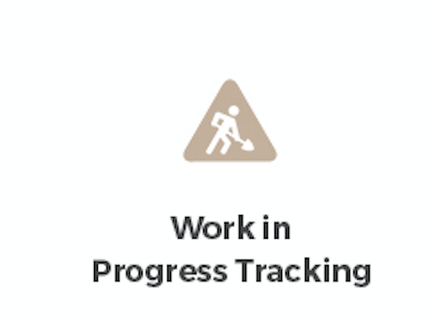
Comments：
Individual banner
Logistic management
Title
RFID In Logistic Management
Logistics is the flow of resources between the manufacturing area and the area of supply in order to meet the requirements of customers or corporations. Logistics is a constantly changing field which involves transportation, inventory, material handling and packaging. Radio Frequency Identification (RFID) is a data collection technology that uses electronic tags for storing data. RFID is an automated form of identity verification. Other examples of such forms are Bar codes and scanner.
Detailed description of this application
Up one is the application detail page, this is not what we are willing to get, it is better that all the content is shown on one page, audience do not need to click to see more content;
Crepak tag solution for Logistic management
Product for this solution
There needs a name of the product under the pic
Successful story list
General advise for application page:
1. There should be 5 modules in the page:
Banner, application detailed description, crepak tag solution for this application, Successful stories, Other solutions;
2. For the application detailed description, tag solution and successful stories module, if it make sense, please use different color background to classify
3. Please remove all the line of the frames;
Successful story
Bosch factory
Huawei project
CRCC proeject
Other solutions
1.Other solutions, no need brief description of the solution, a general icon and the name of this application under the icon is ok;
2. Width and heigh of each solution should be much smaller, because the main part of this page is details of the solution, other than others;

Slide 3
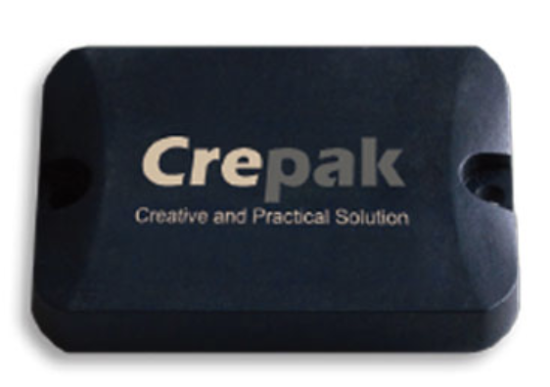
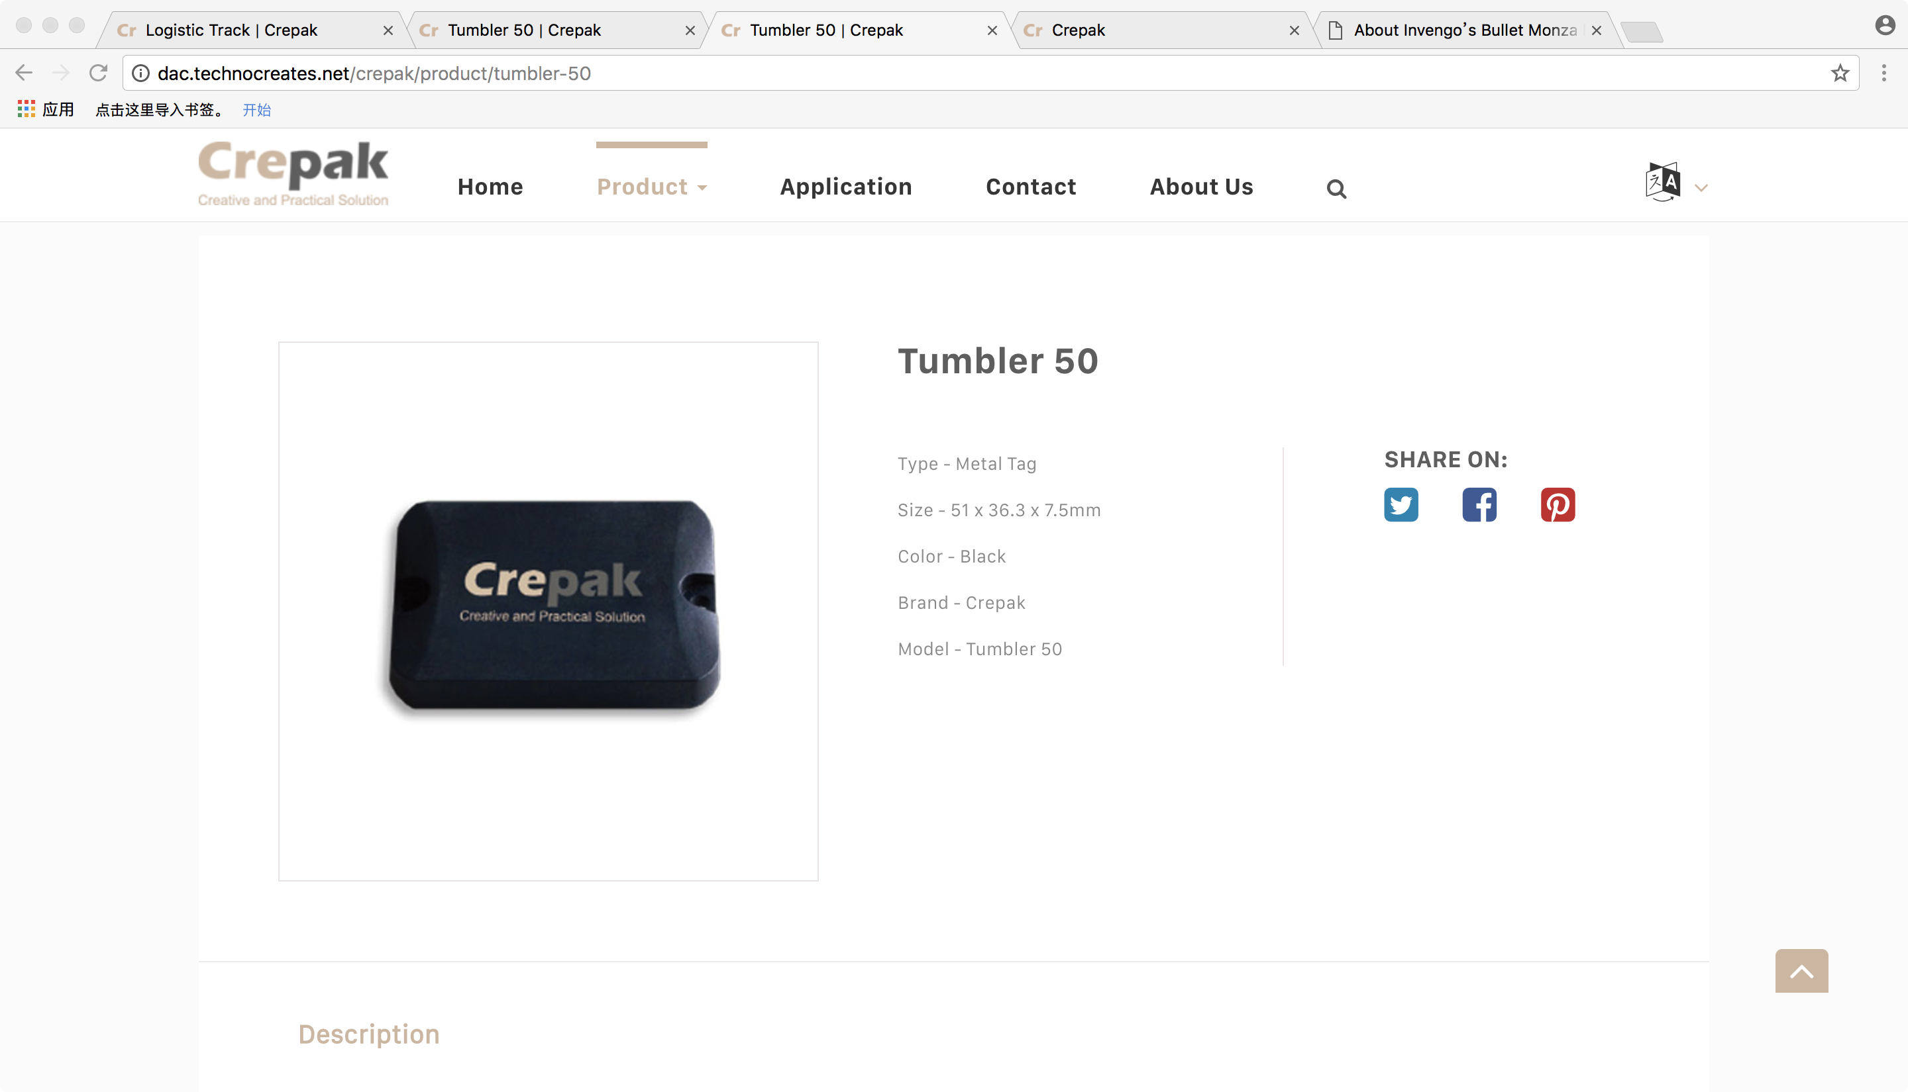
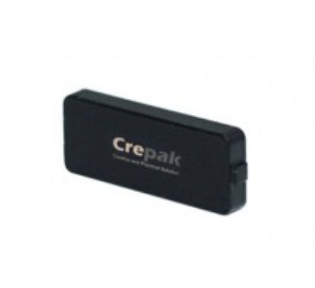
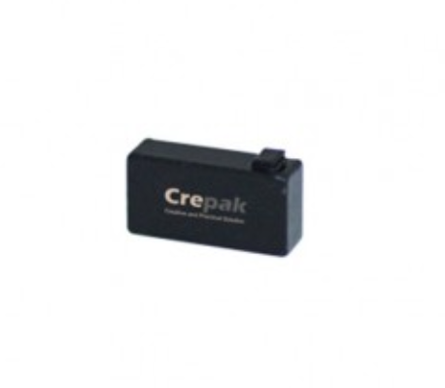
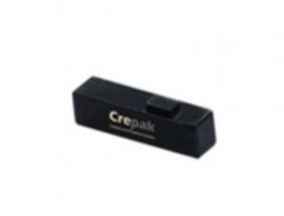
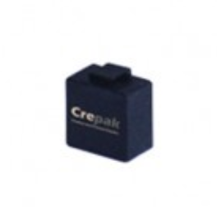
Comments：
Tumbler 50 tag
Excellent performance High temperature Durable
Product name and key words
The Tumbler 50 is a robust product developed to meet customer demand of high temperature, dusty, chemical and other harsh industrial environments application
Product Pic
Brief introduction
Features&Benifit
Special chip package protection ensures tag to survive at temperature up to 250℃
Ruggedized housing and smart structure ensures durability and longevity, with IP68
protection rating;
Read range over 10 meter while mounted on metal
Customizable with clear laser etching and other human readable character
Multiple attachment methods: two holes for screw or rivet mounting, high strength
adhesive, or supplied with a metal plate as an optional weld bracket
Feature and benefit description
Download Datasheet
Datasheet download
Tumbler 50 datasheet CN
Up one is the product details page, this is not what we are willing to get
Tumbler 50 datasheet EN
Related products
General advise for application page:
1. There should be 6 modules in the page:
Product name and key words
Brief introduction
Product pics
Feature&benefit
Datasheet download
Related products
2. Please use unique color background for the product name and key words, like gray
3. Please remove all the line of frames
Tumbler 40
Tumbler 30
Tumbler 20
Tumbler 10
1. Related products, no need brief description of the solution, a general pic and the name of this application under the icon is ok;
2. Width and height of each product should be much smaller, because the main part of this page is details of the product, other than other products;

Slide 4
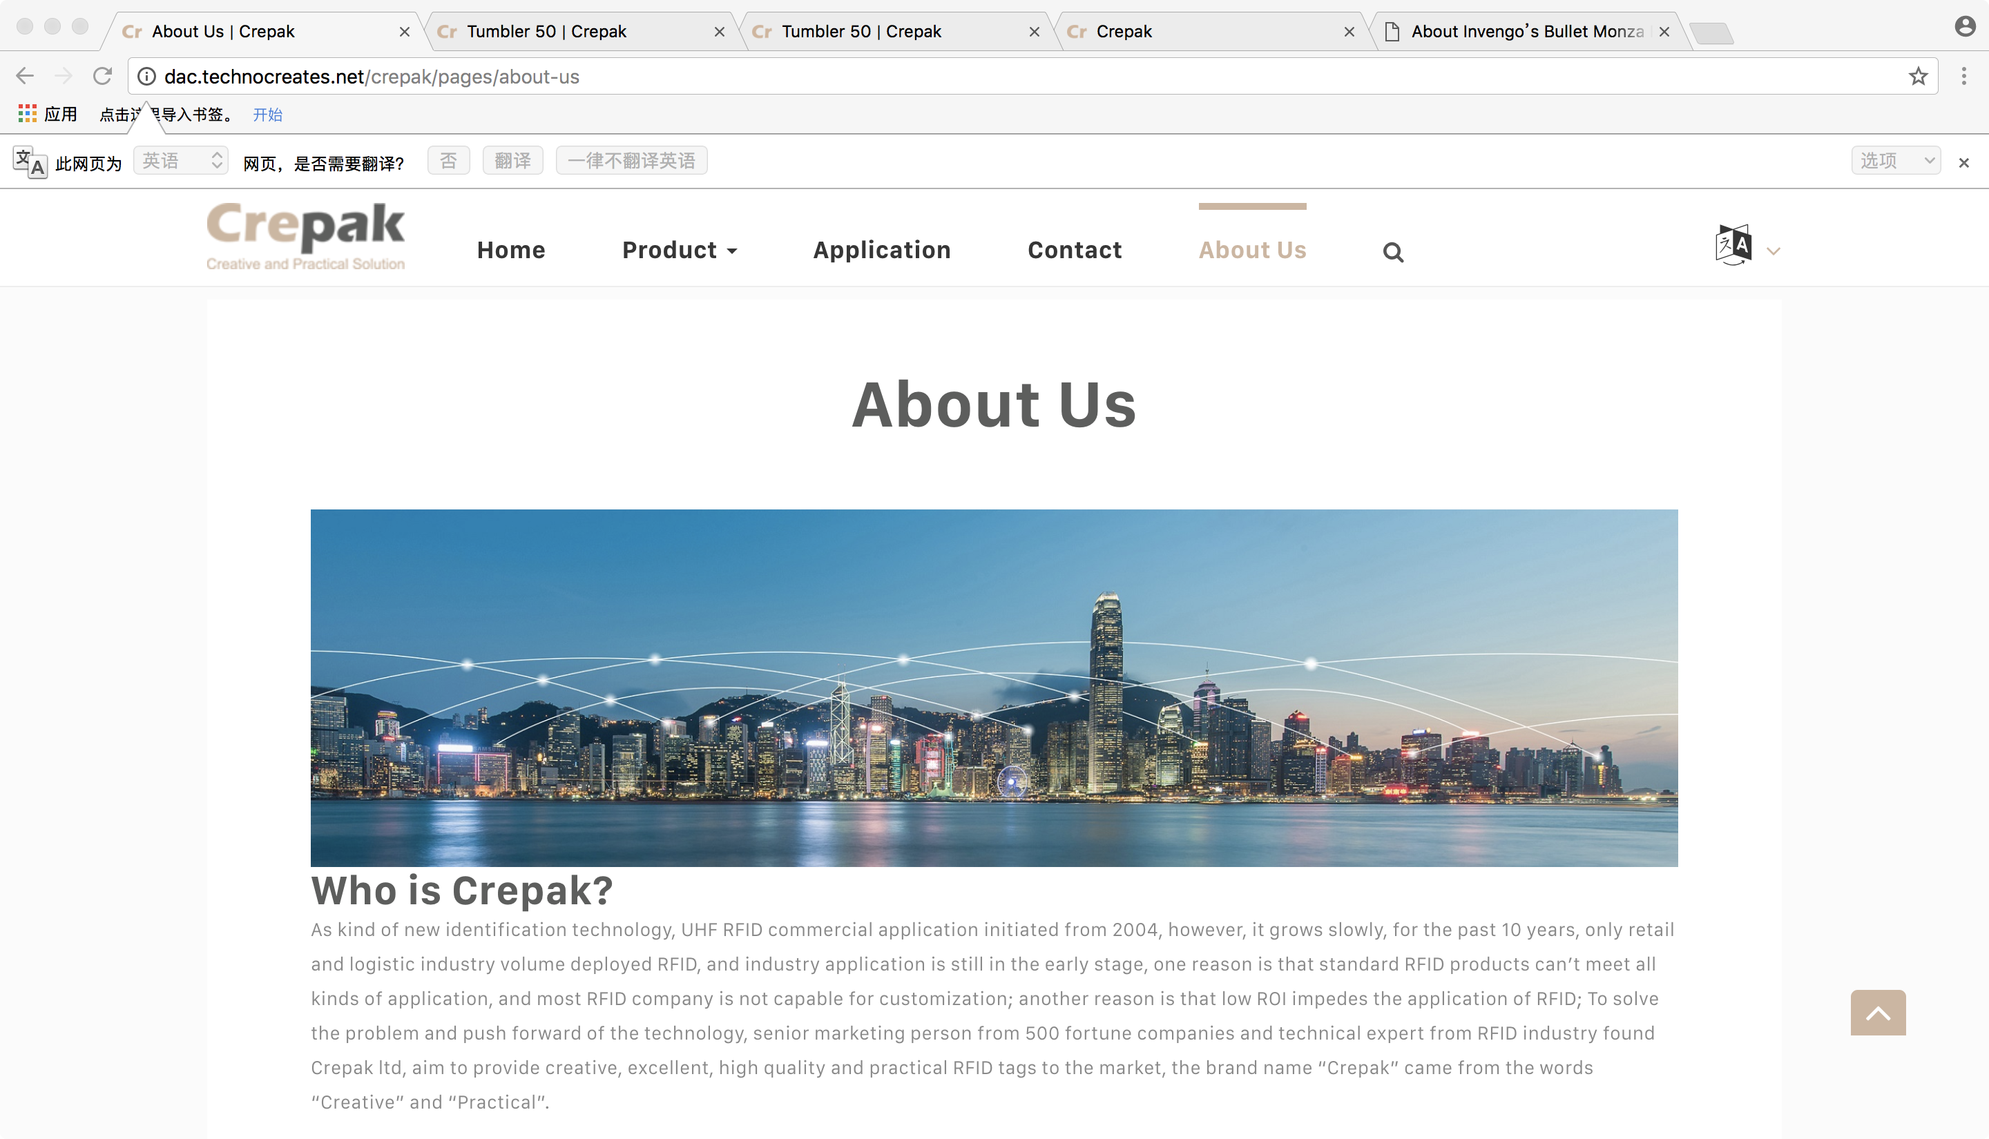
Comments：
There need two sub menus under About US, one is company introduction, then it goes to this page; the other is news and events, then it goes to news and events page, with similar structure of company introduction
Regarding Company introduction page:
1. There should be a individual banner;
2.“About US” should be “Company introduction” , and it needs to be below the banner;
3. There is a white background of the content, it is better to remove the with background, or if you want to use the white background, make whole background white, otherwise it looks strange;
For Contact us page, it is better there is a banner up of the map;

